Slide 1
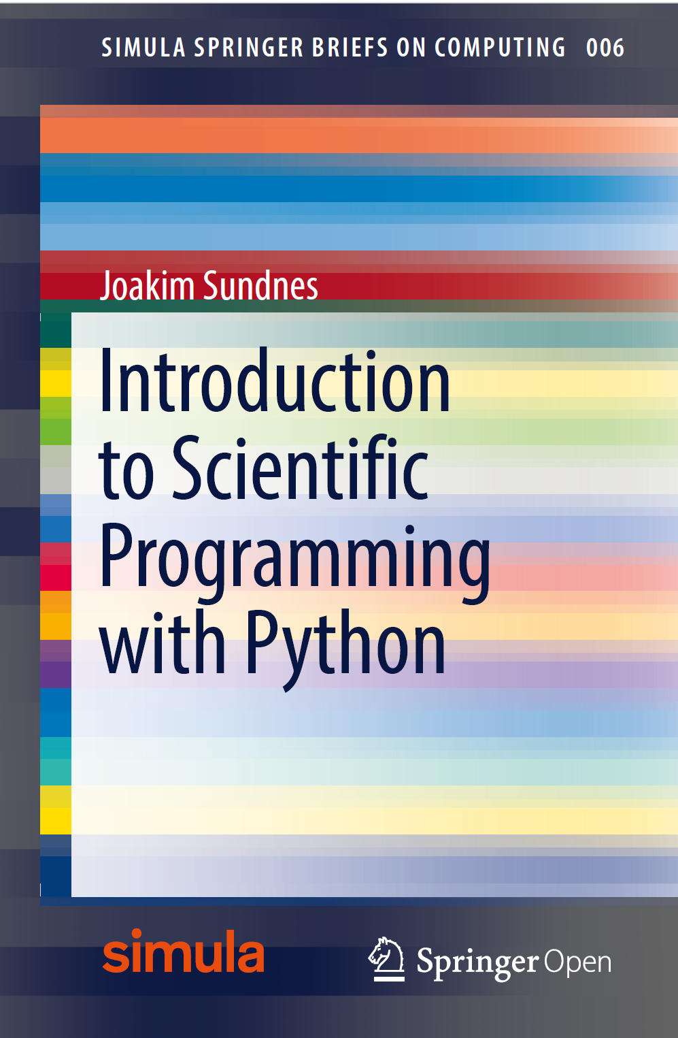
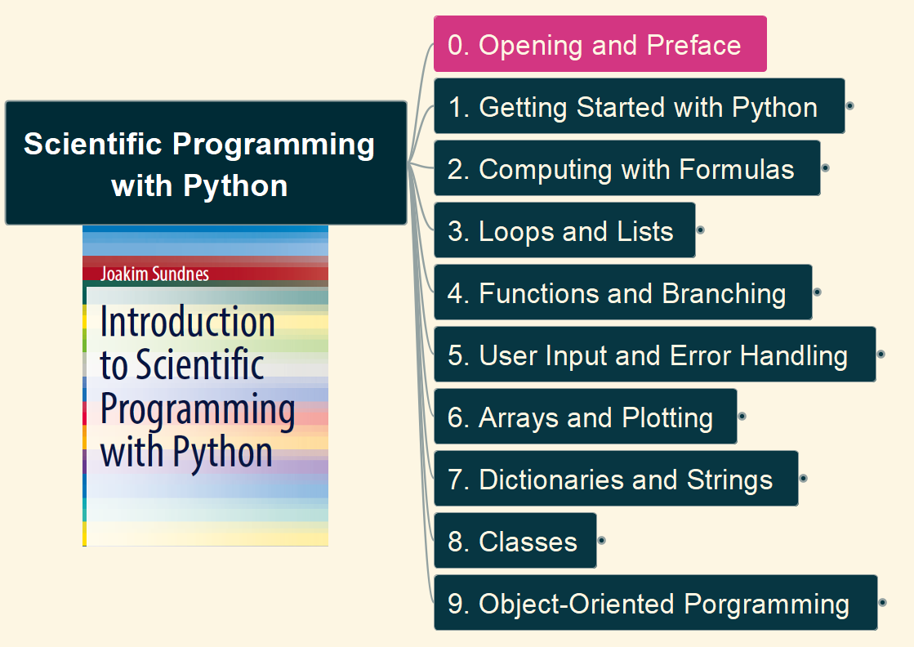
Scientific Programming with Python
001
Opening and Preface

Slide 2
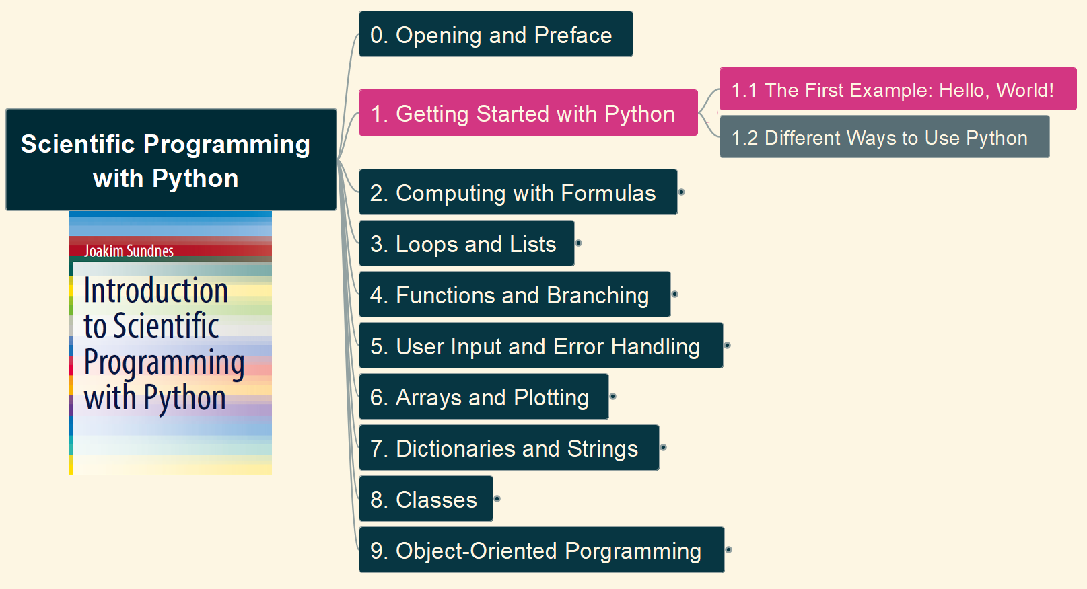

1. Getting Started with Python 1.1 The First Example: Hello, world
002

Slide 3
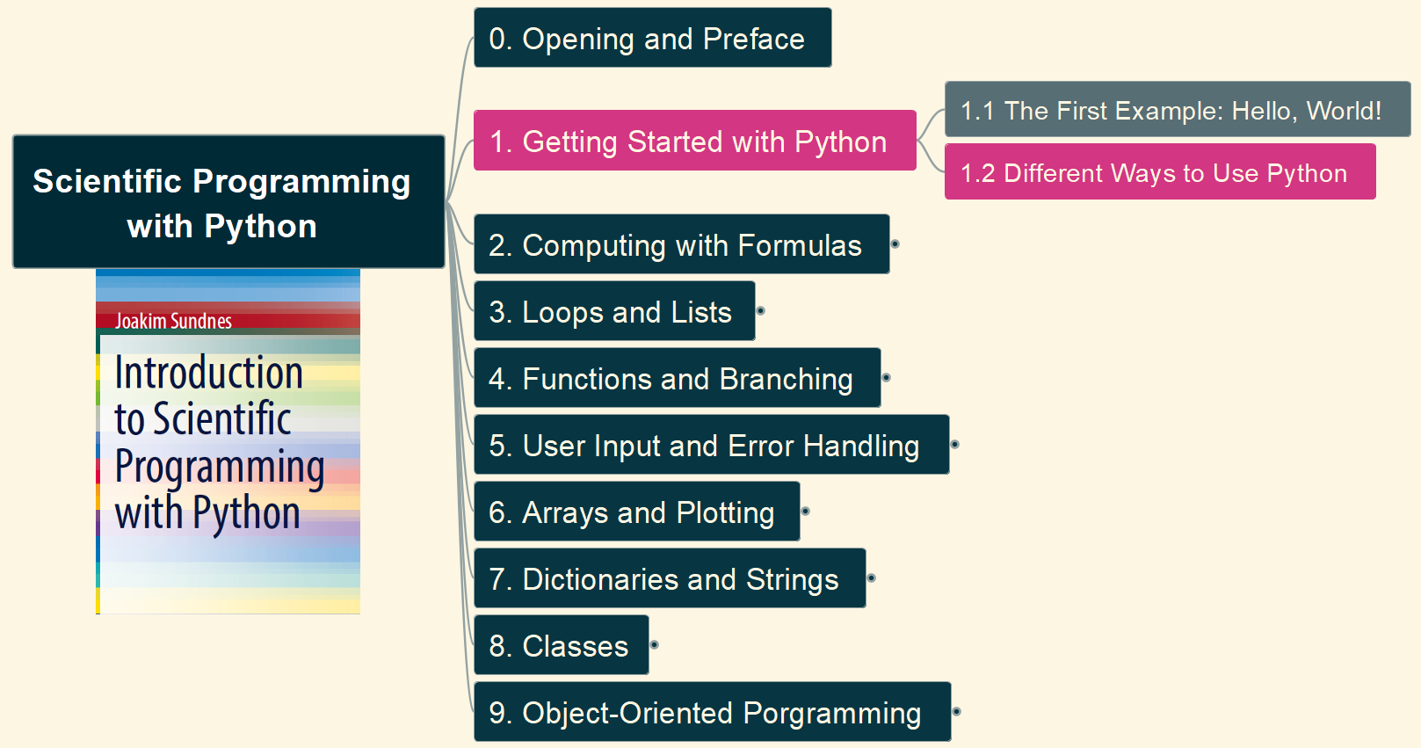
1. Getting Started with Python 1.2 Different Ways of Use Python
003

Slide 4
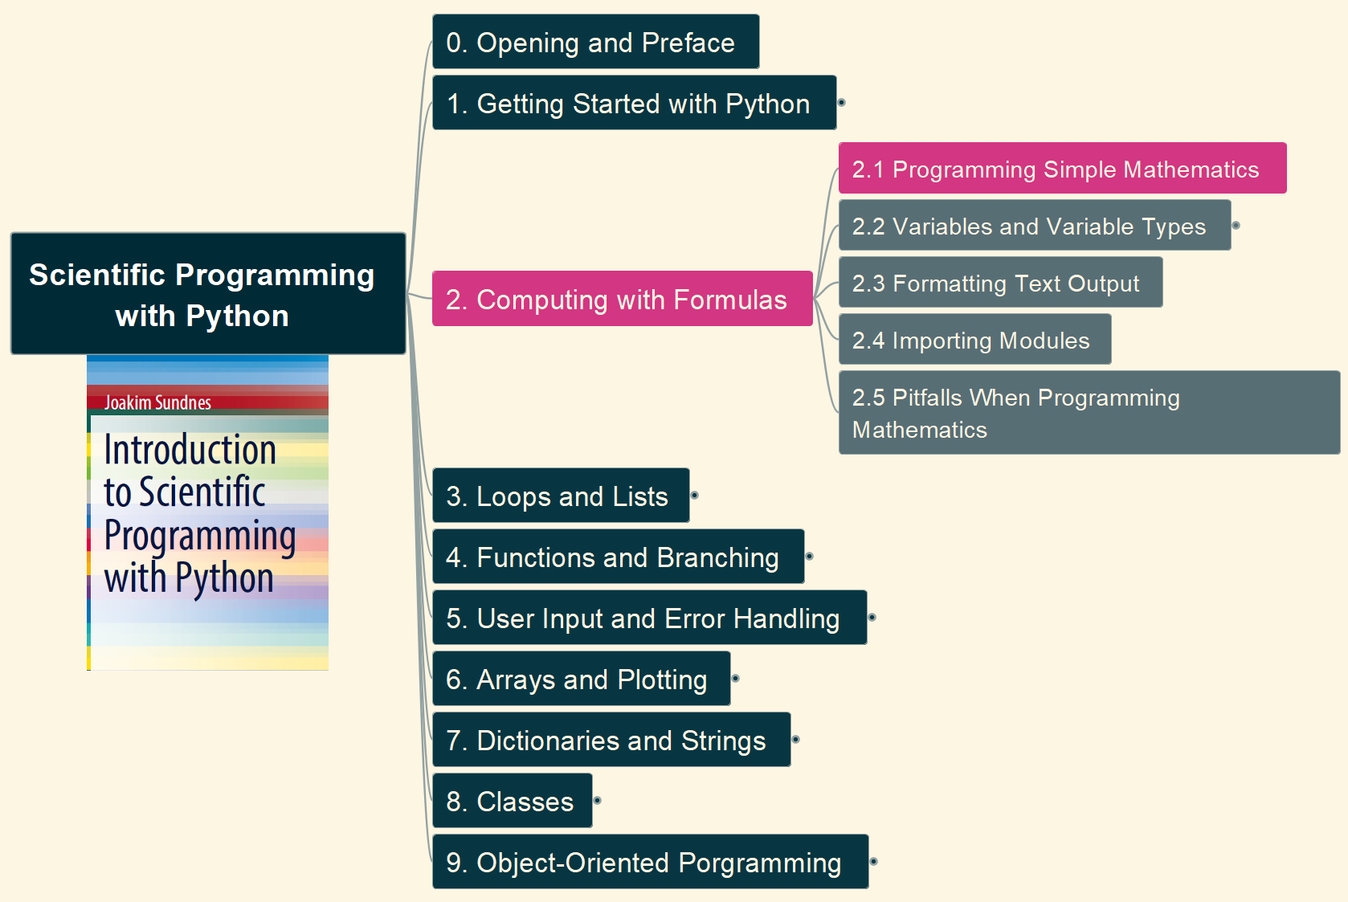
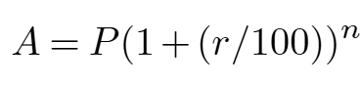
2. Computing with Formulas 2.1 Programming Simple Mathematics
004

Slide 5
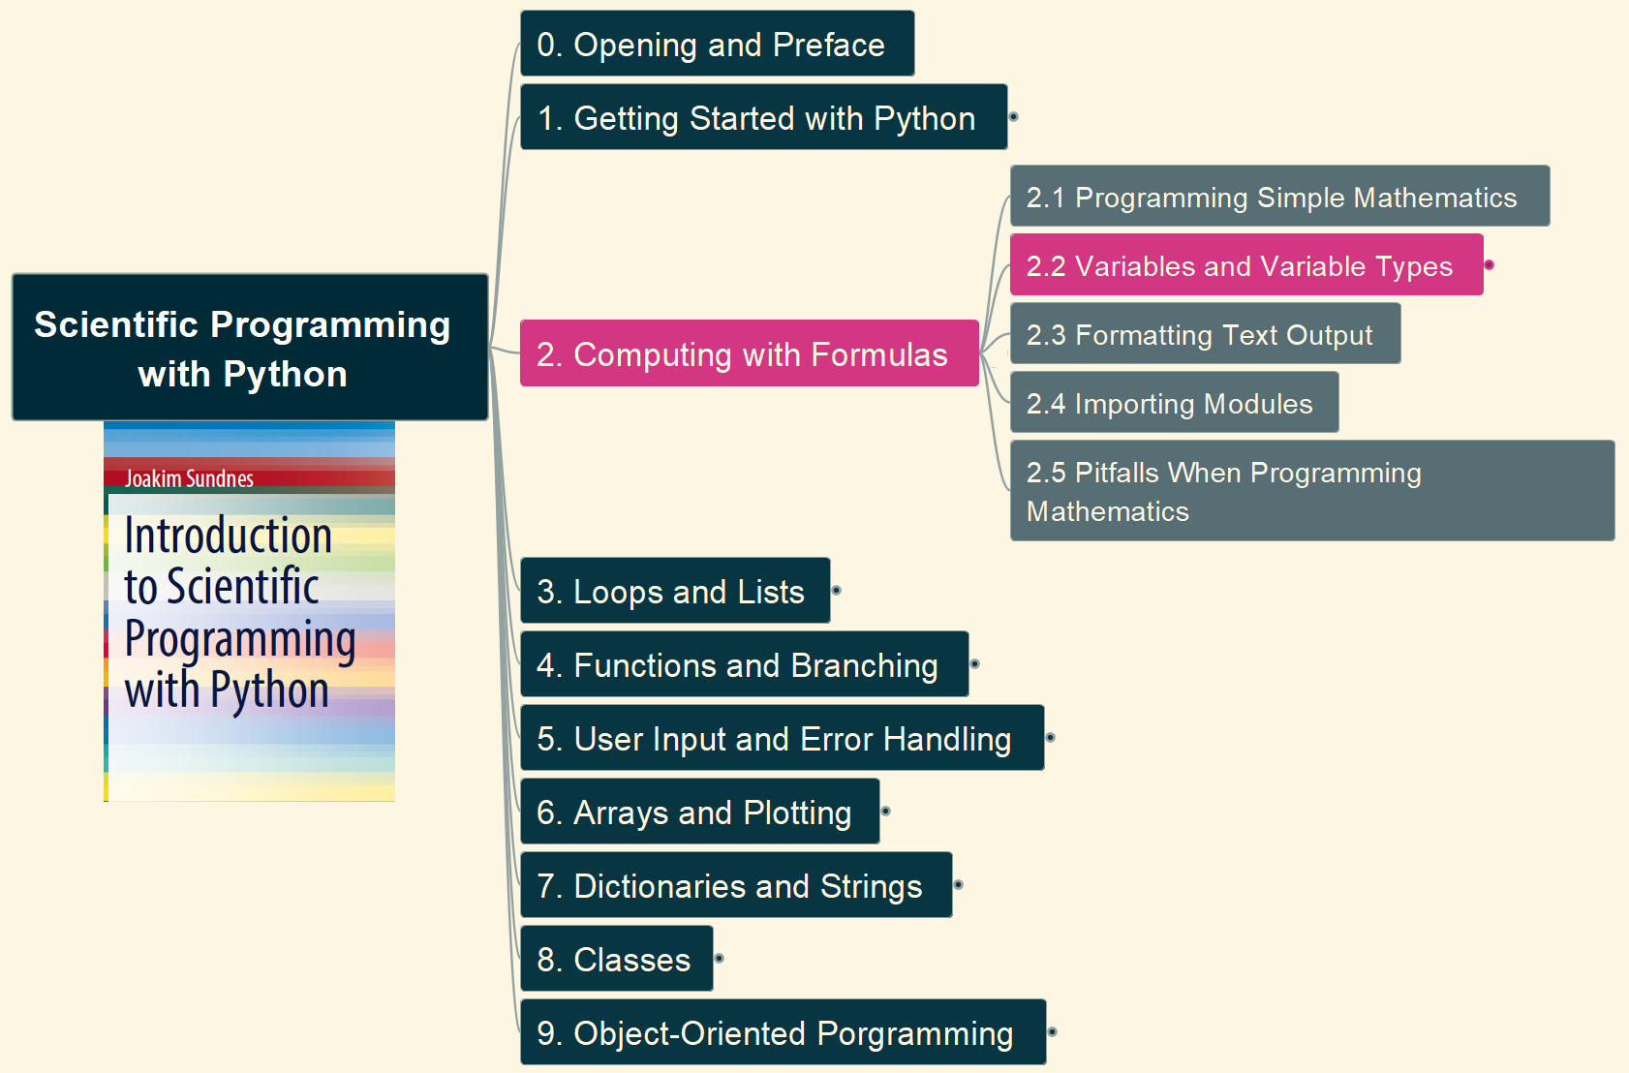
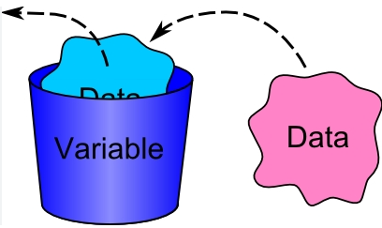
2. Computing with Formulas 2.2 Variables and Variable Types
005

Slide 6
